Slide 2
Scan to load E-Proposal
Proposal
English Proposal
https://vision4.co.th
You could download all the links in website.
Report Sample
Online Slide
Offline Slide

Slide 3
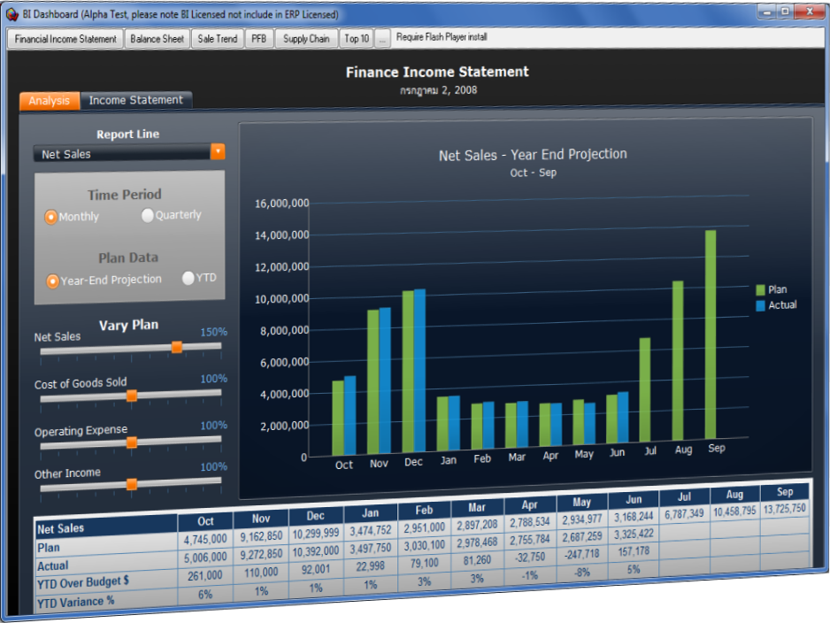
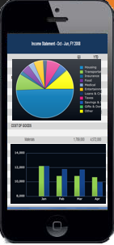
Ready Integrated ERP (Enterprise Resource Planning)
On Premise / On Cloud / Hybrid / With Integrated
. . .Another word is the only right way to go to BI (Business Intelligence) . . .
Notes:
3

Slide 4
What is ERP ?
Silo (Separate Databases)
ERP Next-Gen Support Implement On Premise / Cloud / Hybrid / with Integrated
DS
(Data Science)
BI
(Business Intelligence)
Need real business data from ERP
Manual
&
Excel
Project Software
Account Software
ERP Solution
Include
Account Module (FRM)
Inventory Module (SCM)
Production Module (MRP)
HR& Payroll Module (HRM)
CRM Module (CRM)
Maintenance Module (EAM)
Logistic Module (SCM)
Organize Management (OM)
And more…
With Single Database
Inventory Software
Production Software
HR & Payroll Software
CRM Software
Maintenance Software
Logistic Software
Notes:
4

Slide 5
Data Science
BI (Business Intelligence) / DA (Data Analytic)
SQL Server Analysis Service
Advance Excel
Power BI
Power Platform
Google Data Studio
Qlik
…
Data Source with Automated or Manual
Data Mart
Data Warehouse Data Lake
Data Mining
Cube Data
ERP Data
Data Engineer / ETL
Big Data
Raw Data

Slide 6
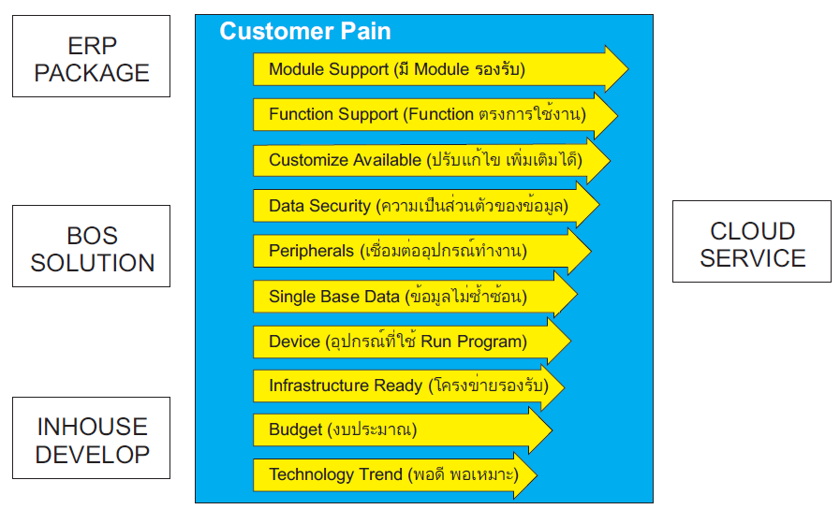
ERP Trend (One Target Multi Route)

Slide 7
Agenda
Product Overview
System Module
Ecosystem
Hardware Tools
GUI (Graphics User Interface)
Main Business Flow
Monitoring & Reporting
Back Office Support Module
Next Generation Module
Question
Notes:
7

Slide 8
Product Overview
Notes:
8

Slide 9
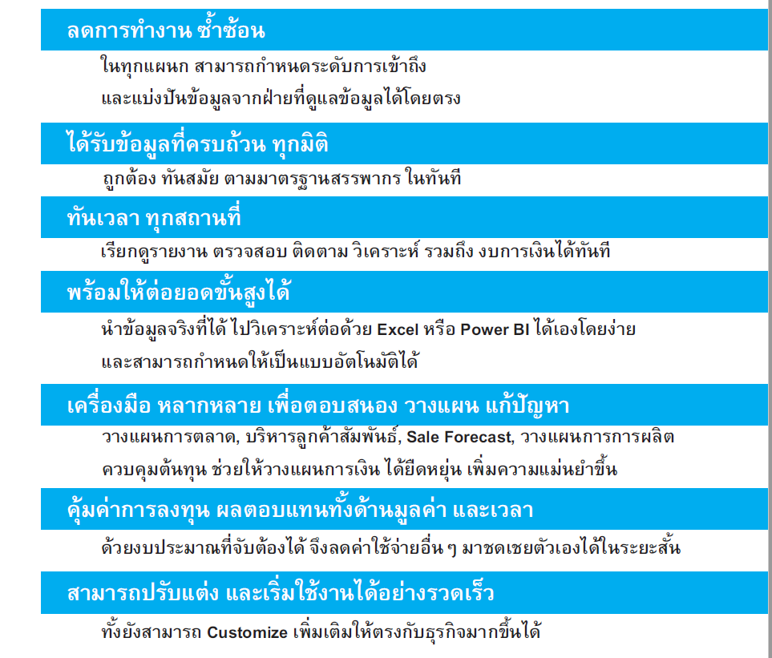
What is your Benefit ?

Slide 10
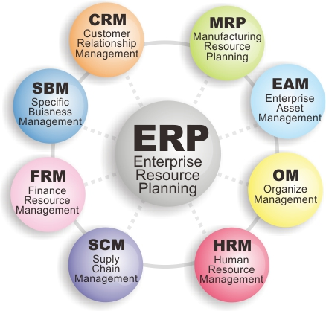
System Module
Notes:
10

Slide 11
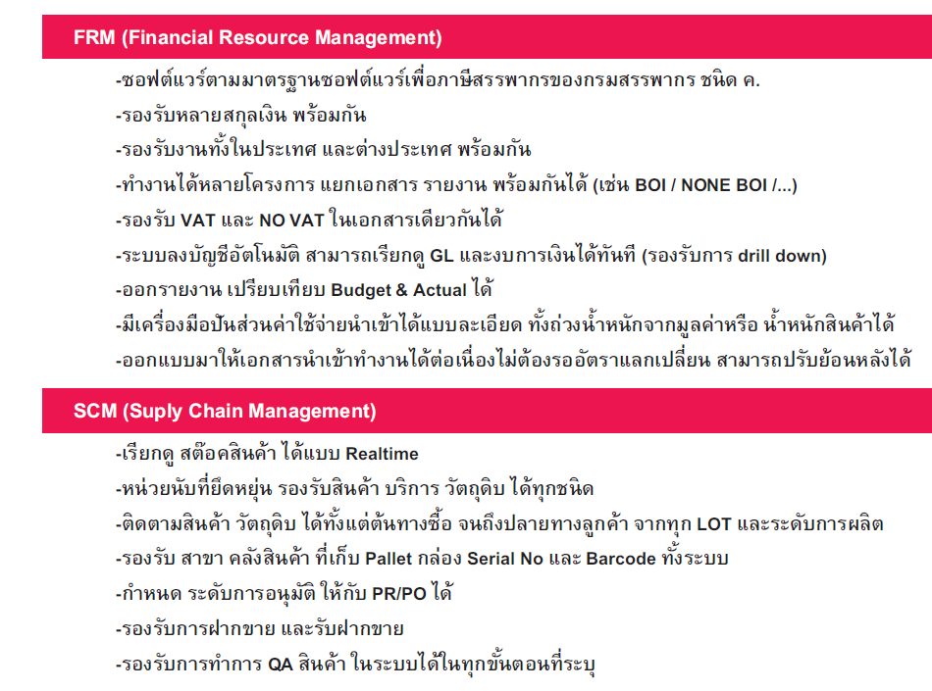
Key Feature ?

Slide 12
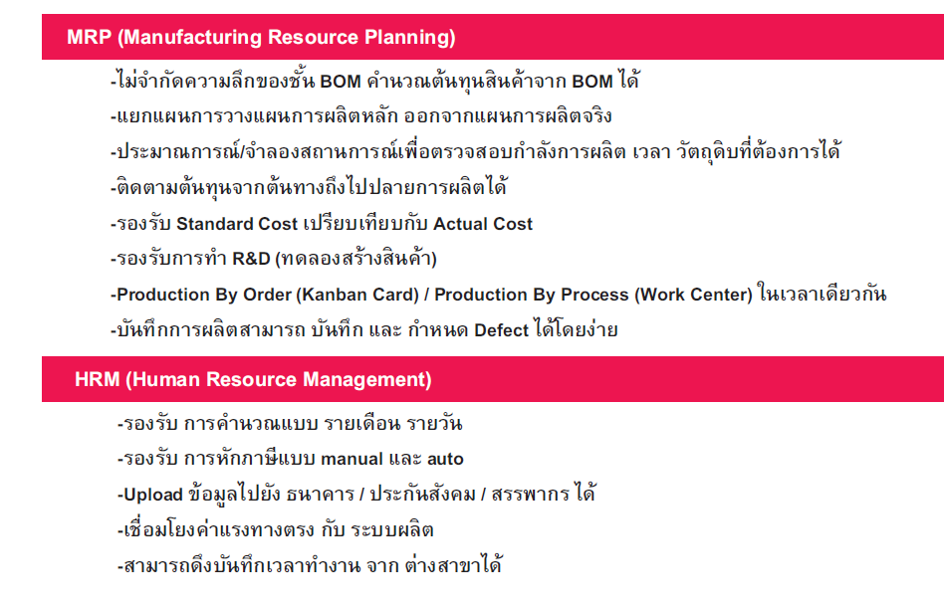
Key Feature ?

Slide 13
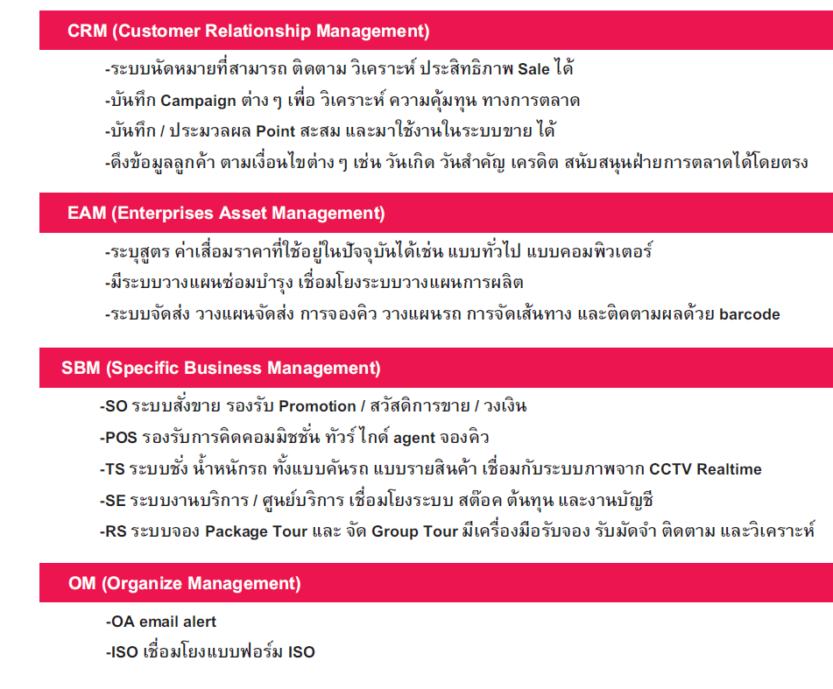
Key Feature ?

Slide 14
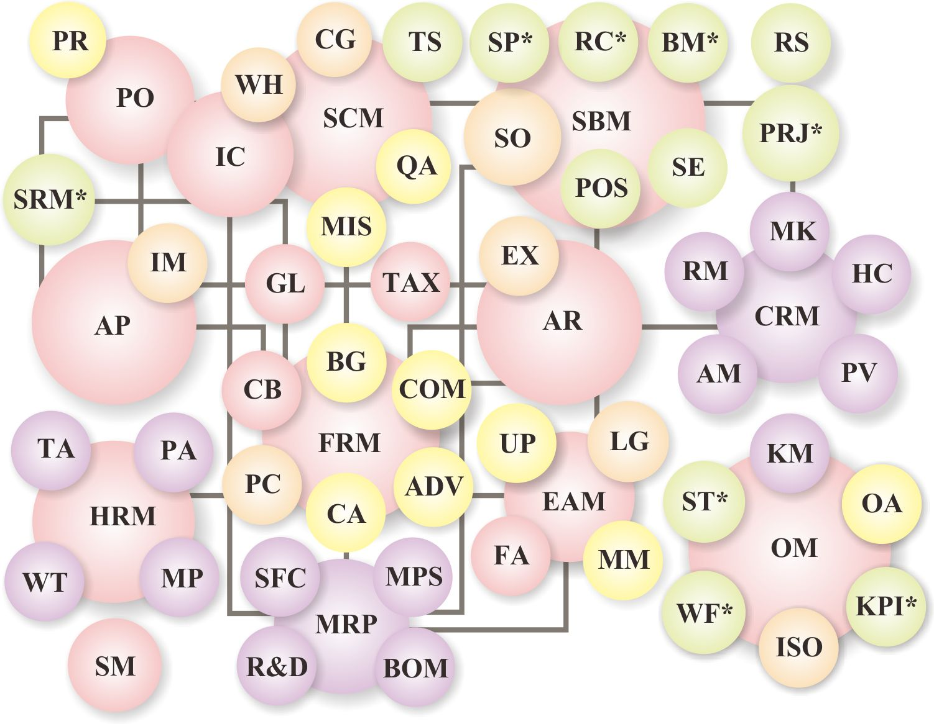
System Module

Slide 15
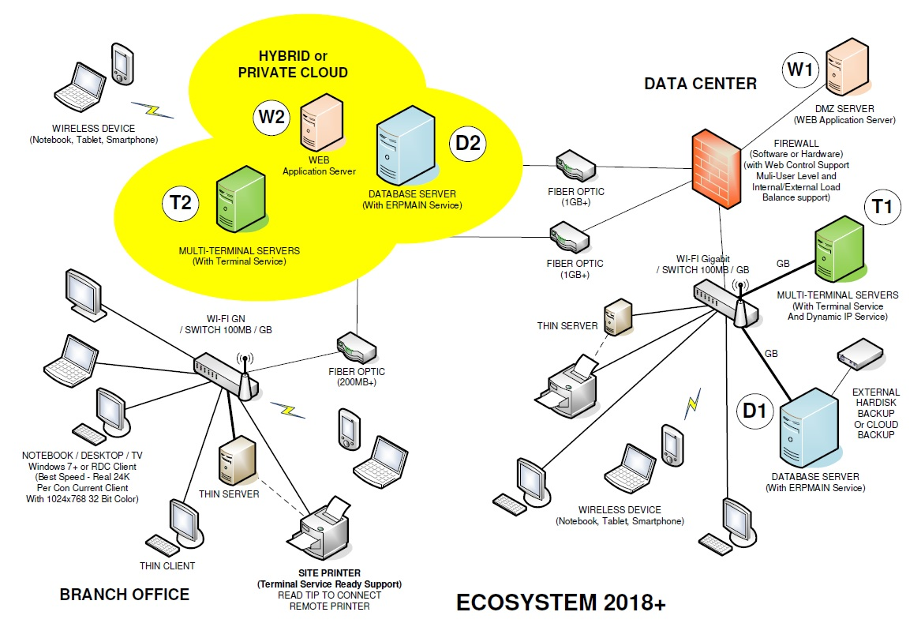
Ecosystem
Notes:
15

Slide 16
Hardware Tools
Notes:
16

Slide 17
GUI
User Friendly, Easy Manage
Notes:
17

Slide 18
Multi Companies , Multi Branches Licensed
Windows 7,10 32-64bit
Windows Server 2008,2012,2016,2019 32-64bit
(WinRT, Linux, MacOS, iOS, Android by Web* & Remote desktop)
Notes:
18

Slide 19
SM (System Management)
Multi Level & Deep Permission, Email Alert, Log
Quick & Easy to Import & Export Data
Notes:
19

Slide 20
Process
Main Business Flow
Notes:
20

Slide 21
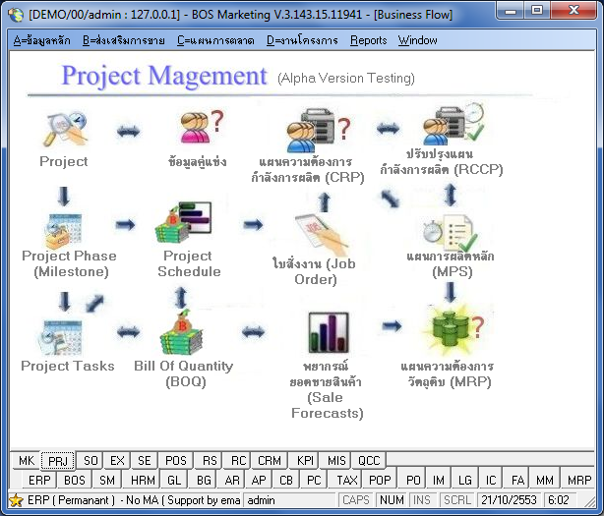
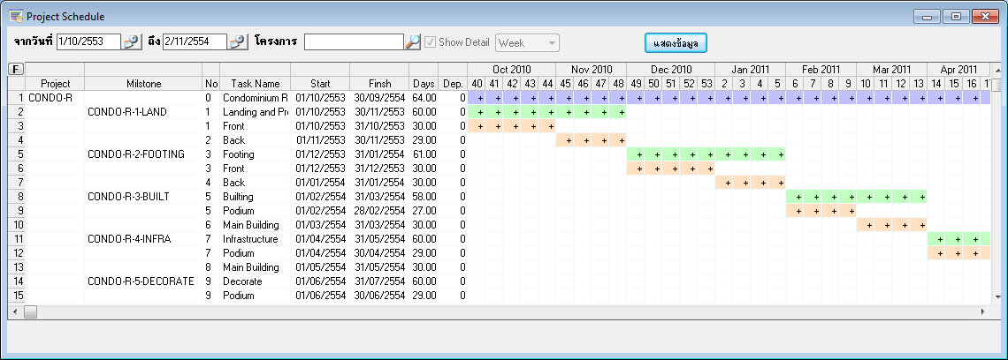
Marketing, Sale Target, Forecast & Project
Notes:
21

Slide 22
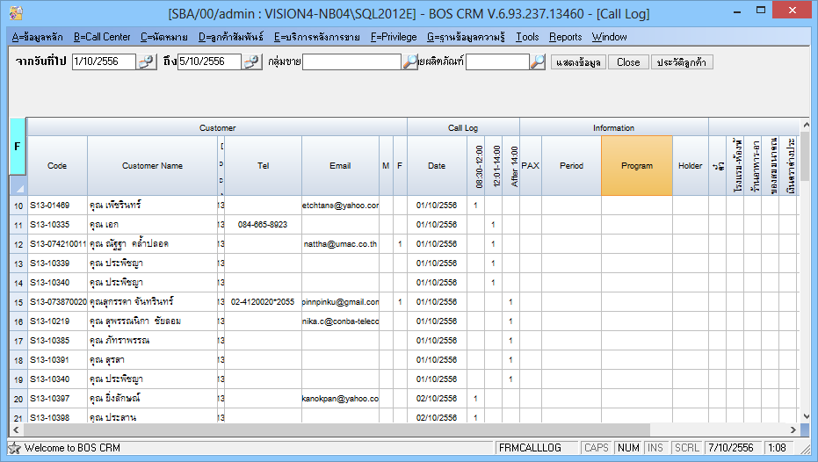
Prospect, Activities, Appointment, Call Log Opportunity, Inquiry and Potential tools
Notes:
22

Slide 23
Estimate Production Real Time Tool (Time)
Notes:
23

Slide 24
Estimate Production Real Time Tool (Material)
Notes:
24

Slide 25
Sale Order / Web Order / Tablet Order
Or Off-Line Excel Import Order
Notes:
25

Slide 26
Job Order, Production Order, Process Order
Notes:
26

Slide 27
Capacity Requirement Planning
Notes:
27

Slide 28
RCCP (Rough Cut Capacity) – ReOrder Priority
Notes:
28

Slide 29
RCCP (Rough Cut Capacity) – Recalculation
Notes:
29

Slide 30
RCCP (Rough Cut Capacity) – Bulk Order
Notes:
30

Slide 31
MPS (Master Planning Schedule)
Notes:
31

Slide 32
Line Schedule
Notes:
32

Slide 33
MRP (Material Requirement Planning)
Notes:
33

Slide 34
Vendor Pending Schedule & Monitoring
Notes:
34

Slide 35
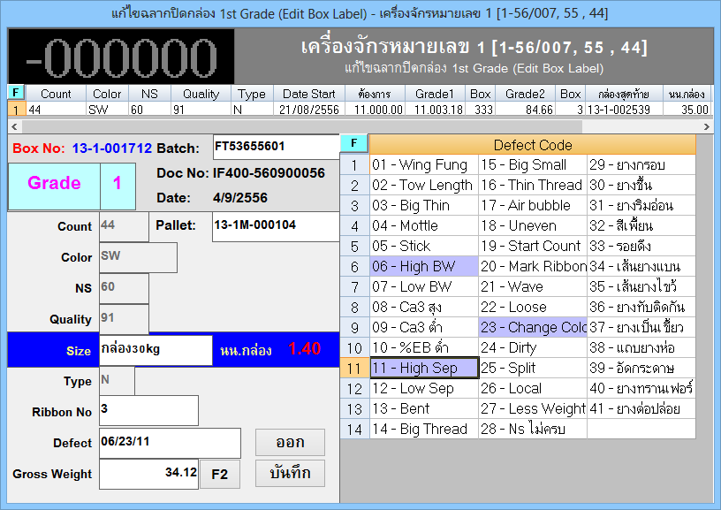
Shop Floor Control, Quick Receive Production Mode
Notes:
35

Slide 36
Advance Receive Production support Outsource, QA, Partial, Scrap, By Product, Actual DL, Factory LOT & Serial, Batch, LOT & Serial, Performance, Bar code, RFID, Link Machine Embedded
With 3 Parallel Units + Unlimited Package Units
Notes:
36

Slide 37
Real time Production Status
Notes:
37

Slide 38
Real time Stock Branch, Location, Pallet, Box Serial No, Status and Virtual Stock
Notes:
38

Slide 39
Drill Down to Source of Document
Notes:
39

Slide 40
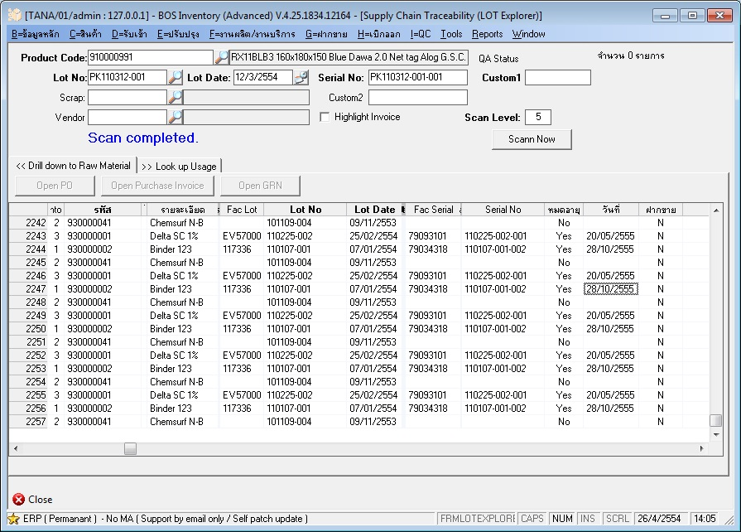
Supply Chain Traceability

Slide 41
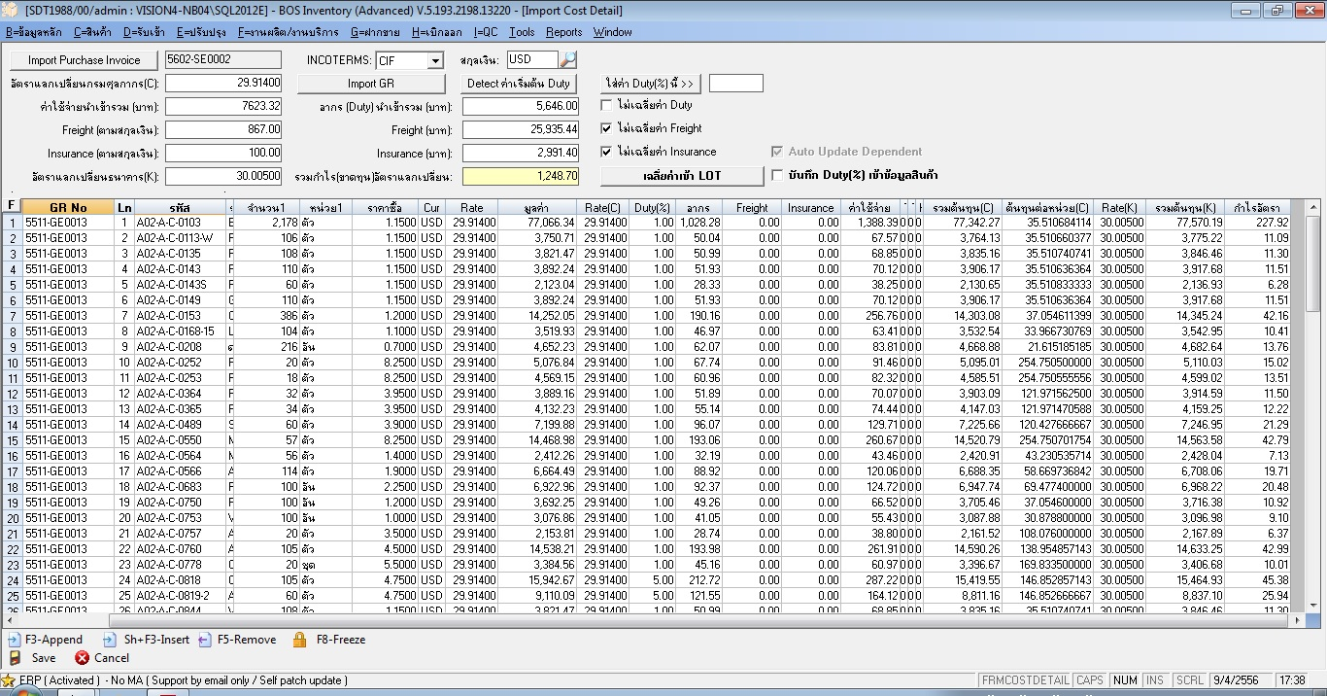
Allocate Import Cost Tool

Slide 42
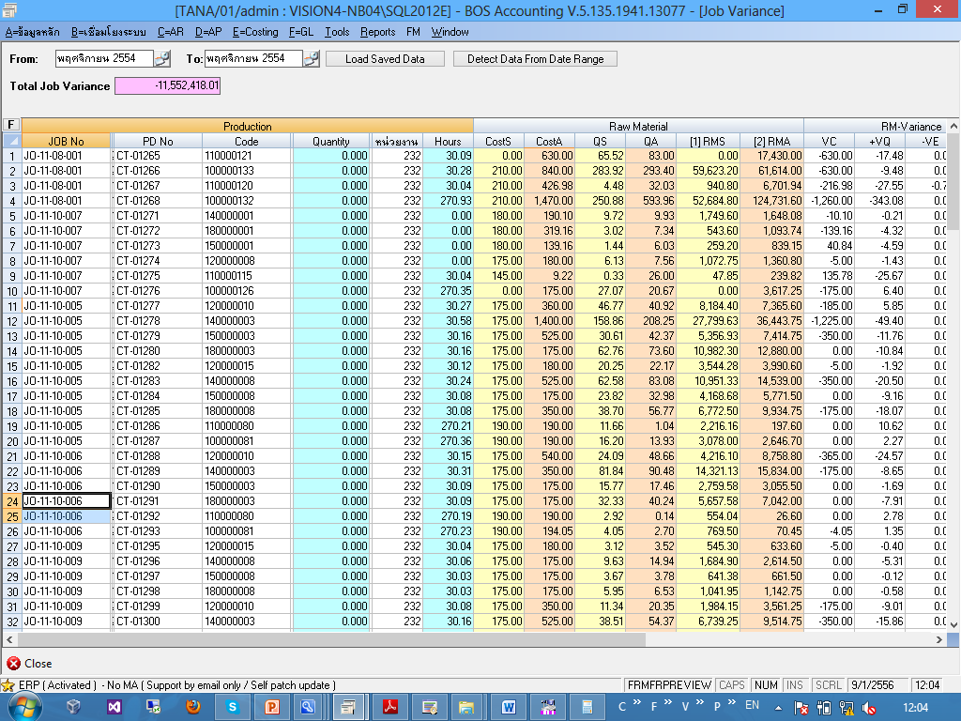
Job Cost & Job Variance Calculator Tool

Slide 43
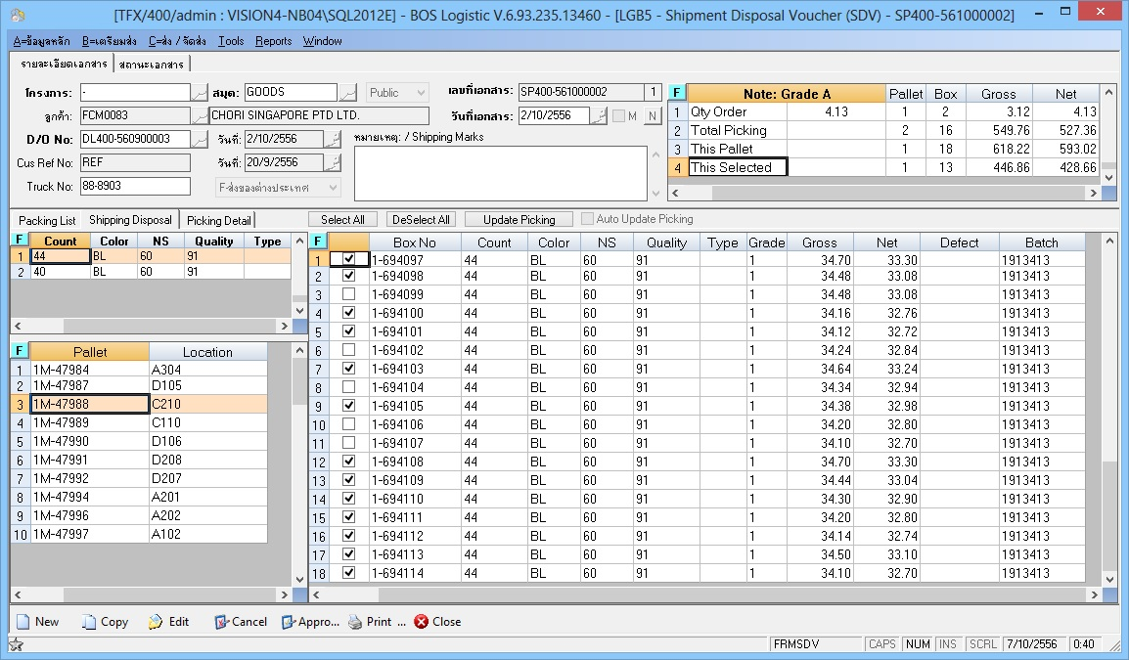
Shipment Disposal Wizard by pallet
control % of defect Picking

Slide 44
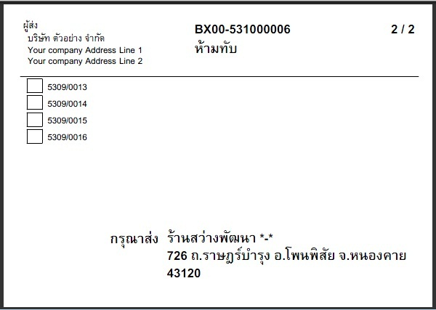
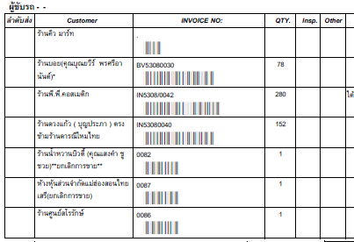
Distribution & Loading Plan with Invoice, Packing List, Box set and Box tag Tool
Notes:
44

Slide 45
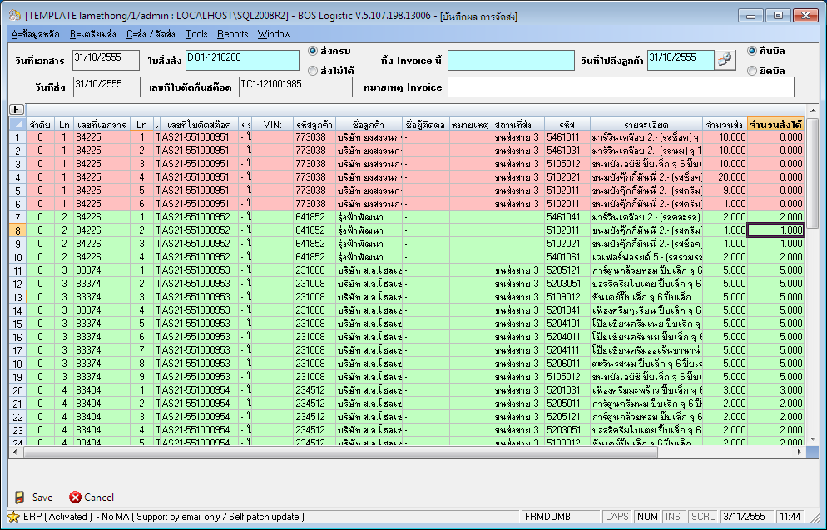
Logistic support Barcode, RFID input
Loading & Customer Stock Tracing

Slide 46
Support All Standard Account function
(AR / AP / GL / TAX / CHEQUE / BANK / ADVANCE / PC) with many custom setting
(5 hierarchy + 3 Dimensions account map)

Slide 47
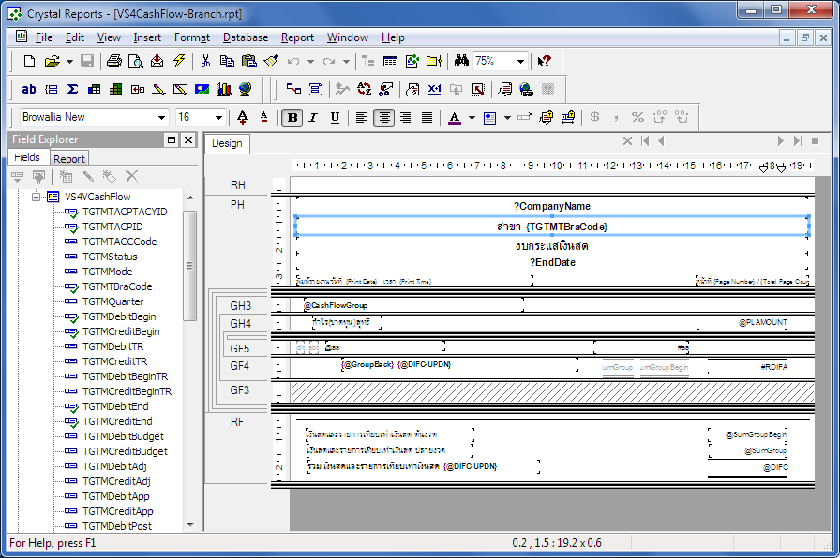
Print Preview, Print Cheque, Print Deposit Slip
Easy to Add & Customize Report by User
Easy to Export to Excel & Print to PDF file
Notes:
47

Slide 48
Process
Monitoring & Reporting
Notes:
48

Slide 49
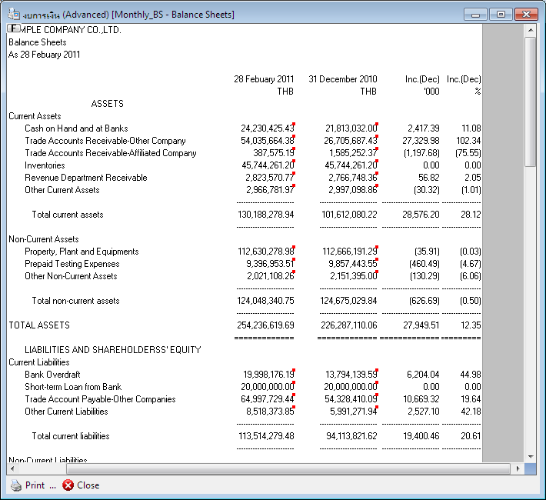
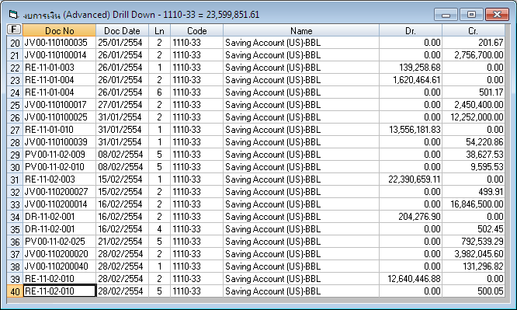
Automatic Financial Report & Advanced Custom Drill down support
Notes:
49

Slide 50
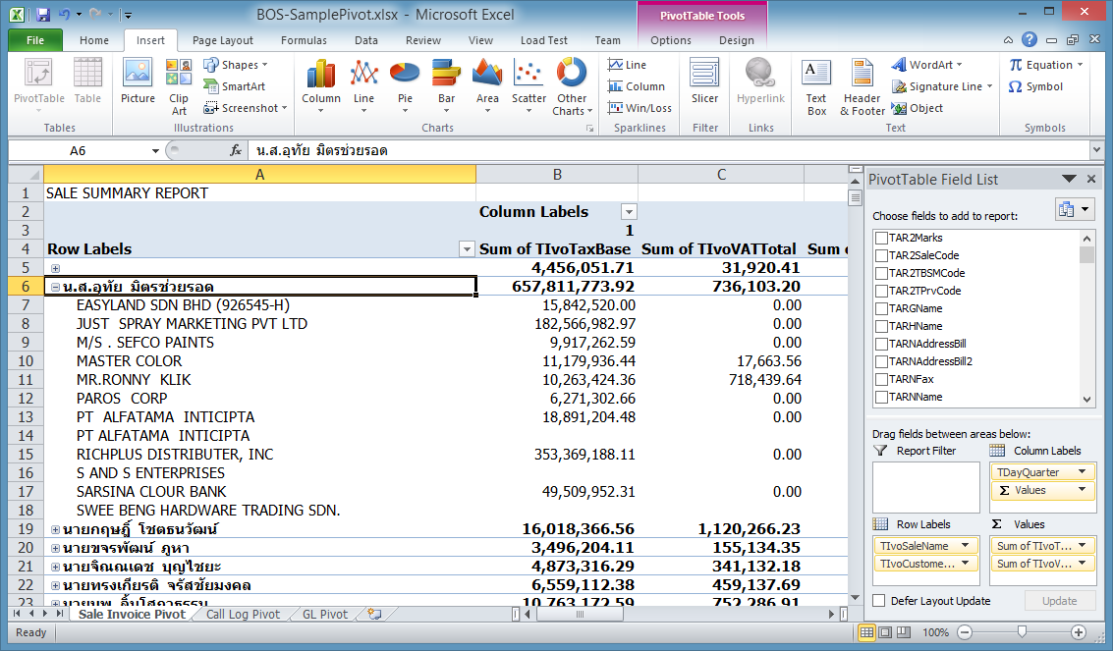
Analysis with Advanced Excel

Slide 51
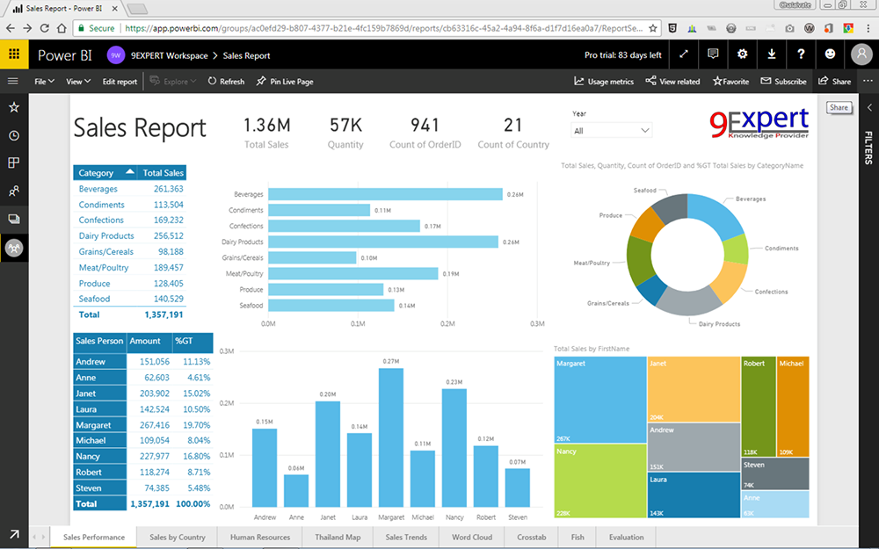
Powerful Dashboard with Power BI

Slide 52
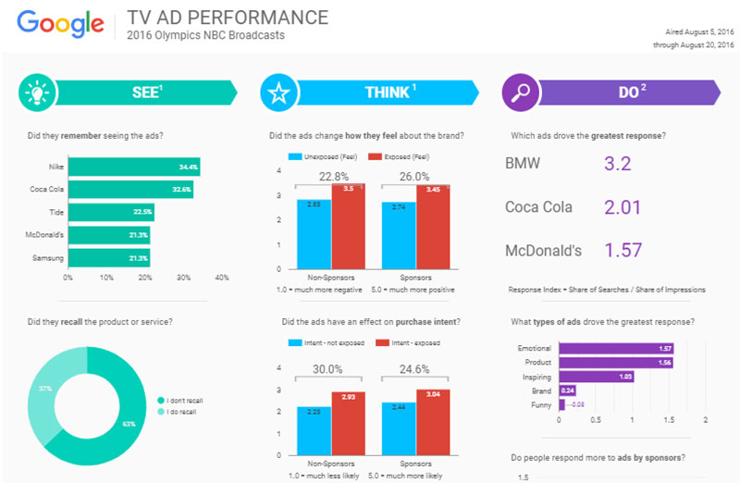
Integrated to Google Data Studio

Slide 53
Process
Back Office Support Module
Notes:
53

Slide 54
HRM (Human Resource Management)
Multi Branch Personnel , Time Attendant, Payroll, Recruitment*, Welfare and Training
Notes:
54

Slide 55
Fixed Asset
Notes:
55

Slide 56
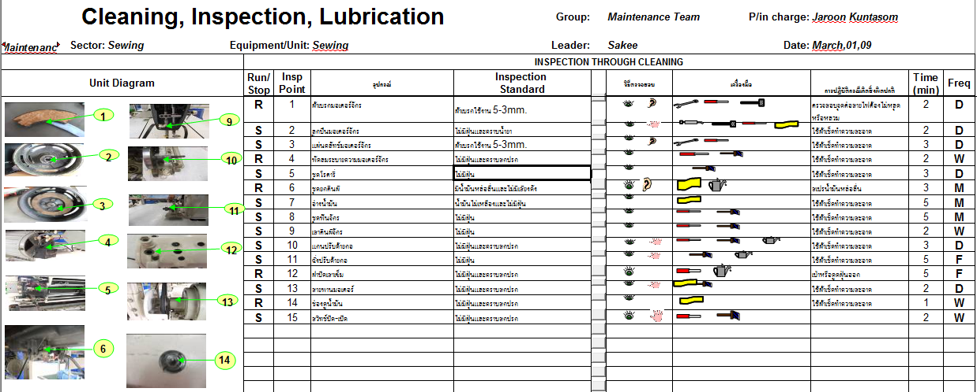
Maintenance Management
Notes:
56

Slide 57
Specified Business Management Module
Notes:
57

Slide 58
Service Center Module
Notes:
58

Slide 59
POS (Point Of Sale) support Tour System
Notes:
59

Slide 60
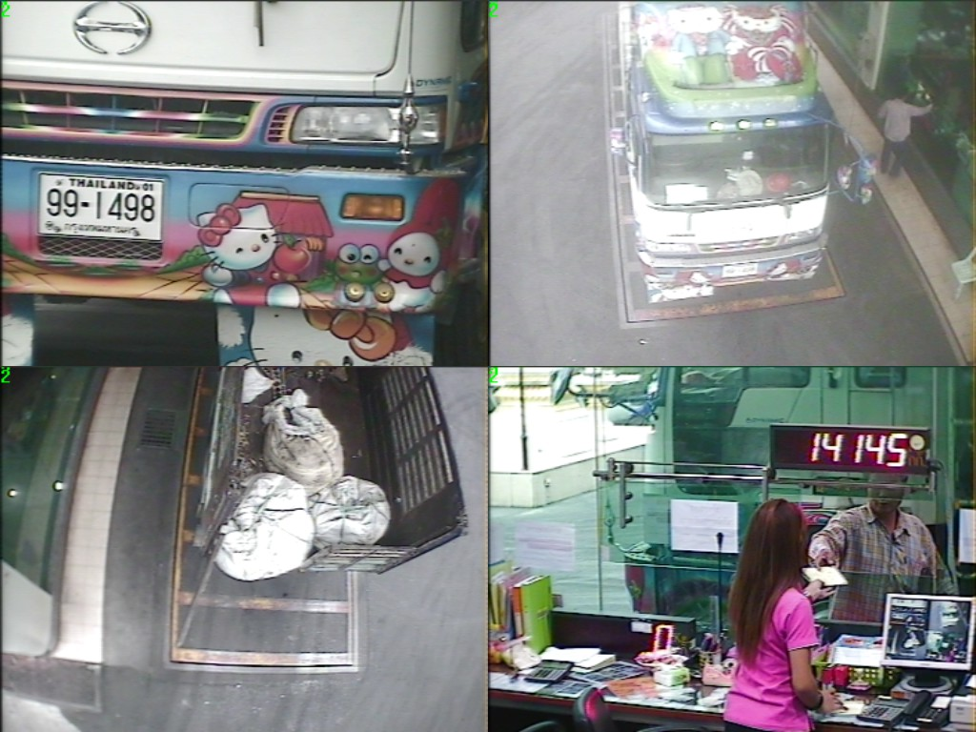
Truck Scale Solution
14145
Notes:
60

Slide 61
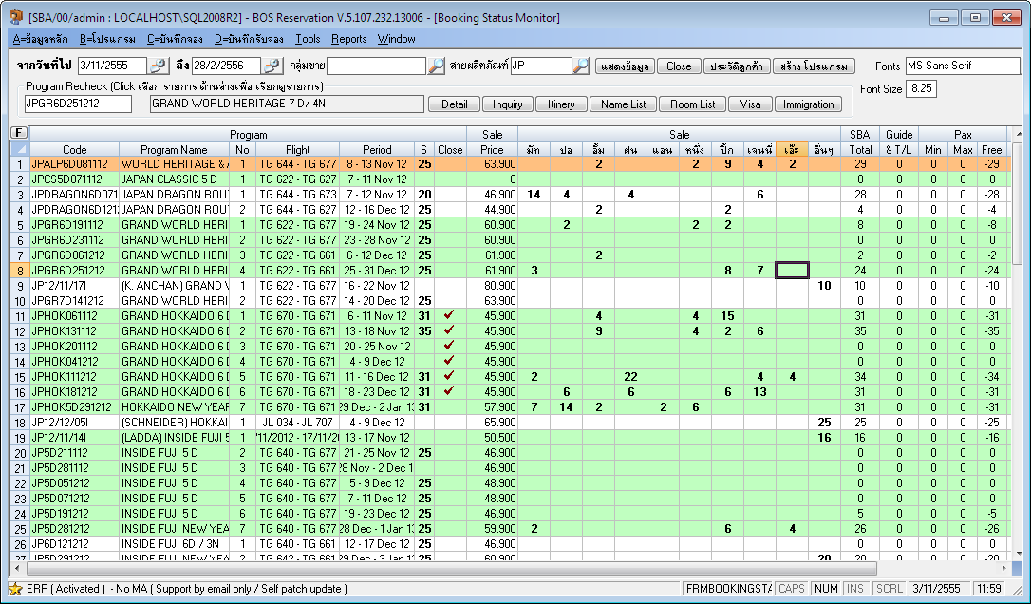
Reservation for Tour & Hotel

Slide 62
Pre Release Module
& Next Generation Module
Notes:
62

Slide 63
KPI* with Self Indicator Design,
ISO* - Document List & Report Stamp
Document Workflow* Designer & Control
Notes:
63

Slide 64
Question
Notes:
64

Slide 65
Notes:
65

